Slide 1
CPU Garage Challenge My Solution & Thoughts
Amichai Ben-David

Slide 2
Agenda
CPU-Challenge Preface
Naïve Solution
Coding Style
Pipe-Line
Multi-Issue
Integer Division Accelerator
Branch Prediction
L1 Instruction Cache
Performance analysis

Slide 3
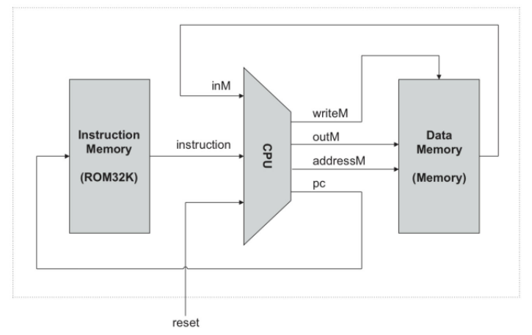
CPU-Challenge Preface
CPU-Challenge Preface
Implementing a "HACK computer“
Compete over best performance on a specific benchmark when loaded to an FPGA
The program has visual feedback that can be seen on a VGA connection from the FPGA.
Links: Hack computer - Wikipedia Home | nand2tetris

Slide 4
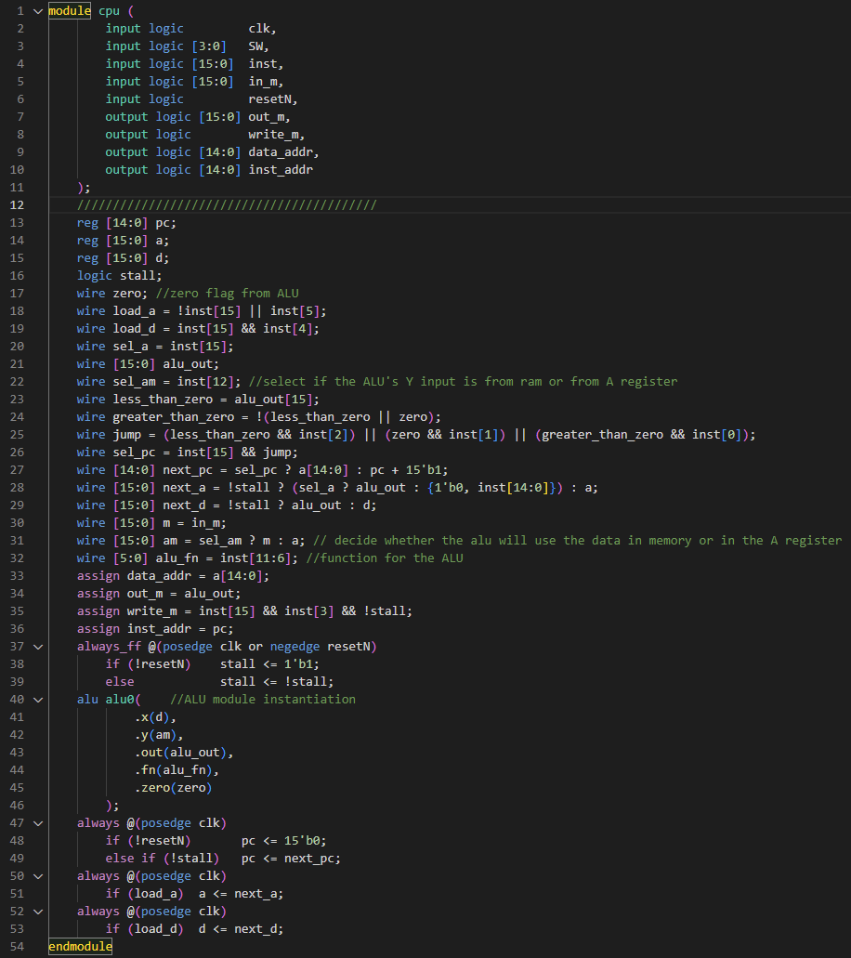
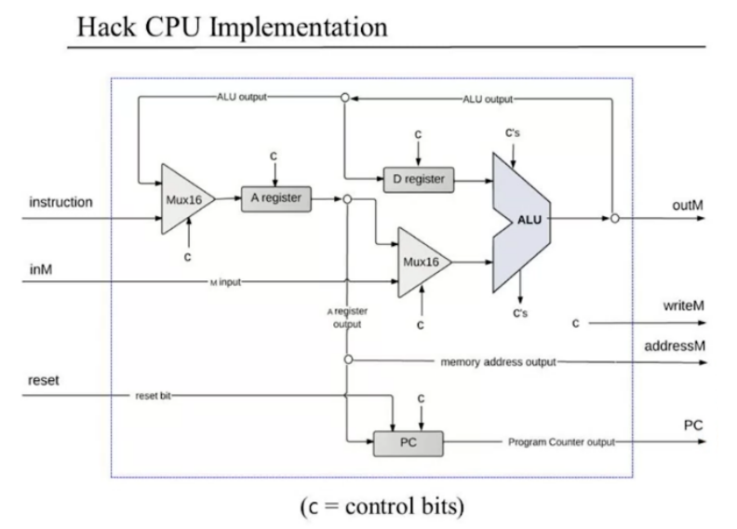
Naïve Solution
Naïve Solution
Single issue
Minimal complexity
Multi-Cycle due to Synchronous memory - See “Stall” signal in RTL

Slide 5

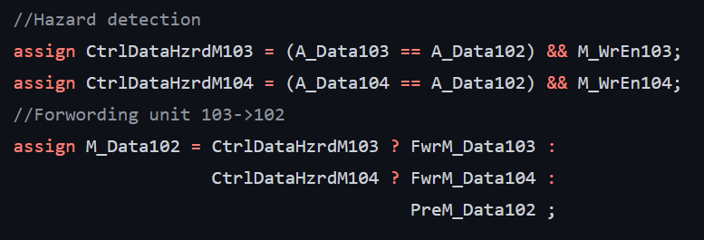
Coding Style
Coding
Style
CamelCase

Slide 6
Coding Style
Coding
Style
`define MSFF(q,i,clk) \
always_ff @(posedge clk) \
q<=i;
`define EN_MSFF(q,i,clk,en) \
always_ff @(posedge clk) \
if(en) q<=i;
`define RST_MSFF(q,i,clk,rst) \
always_ff @(posedge clk) begin \
if (rst) q <='0; \
else q <= i; \
end
`define EN_RST_MSFF(q,i,clk,en,rst)\
always_ff @(posedge clk) \
if (rst) q <='0; \
else if(en) q <= i;
CamelCase
The use of “Macros” for sequential logic (Non blocking assignment)

Slide 7
Coding Style
Coding
Style
CamelCase
The use of “Macros” for sequential logic (Non blocking assignment)
Pipe Staging naming convention
// Sample Ctrl Bits 101 -> 102
`MSFF( SelImmAsAluOut102, SelImmAsAluOut101, Clock)
`MSFF( SelMorA102 , SelMorA101 , Clock)
`MSFF( CtrlAluOp102 , CtrlAluOp101 , Clock)
`RST_MSFF(SsHit102 , SsHit101 , Clock, Reset)
`RST_MSFF(D_WrEn102 , D_WrEn101 , Clock,(Reset || RstCtrlJmp103))
assign NextD_Data102 = AluData102;
//From Cycle 102 -> 101
`EN_MSFF( PreD_Data101, NextD_Data102, Clock, D_WrEn102)
`MSFF( D_Data102 , D_Data101 , Clock)

Slide 8
Coding Style
Coding
Style
typedef enum logic [2:0] {
NO_JMP = 3'b000,
JGT = 3'b001,
JEG = 3'b010,
JGE = 3'b011,
JLT = 3'b100,
JNE = 3'b101,
JLE = 3'b110,
JMP = 3'b111
} t_jmp_cond ;
typedef enum logic {
A_TYPE = 1'b0,
C_TYPE = 1'b1
} t_inst_type;
CamelCase
The use of “Macros” for sequential logic (Non blocking assignment)
Pipe Staging naming convention
The use of Structs & Enums
always_comb begin
// (Inst101[0][15:13] == 3'b111) -> C_TYPE
InstType101 = (Inst101[0][15] == 1'b0) ? A_TYPE : C_TYPE;
M_WrEn101 = (InstType101 == C_TYPE) && Inst101[0][3];
D_WrEn101 = (InstType101 == C_TYPE) && Inst101[0][4];
A_WrEn101 = (InstType101 == C_TYPE) && Inst101[0][5];

Slide 9



Coding Style
Coding
Style
CamelCase
The use of “Macros” for sequential logic (Non blocking assignment)
Pipe Staging naming convention
The use of Structs & Enums
Spaces -> Not TABS!!

Slide 10
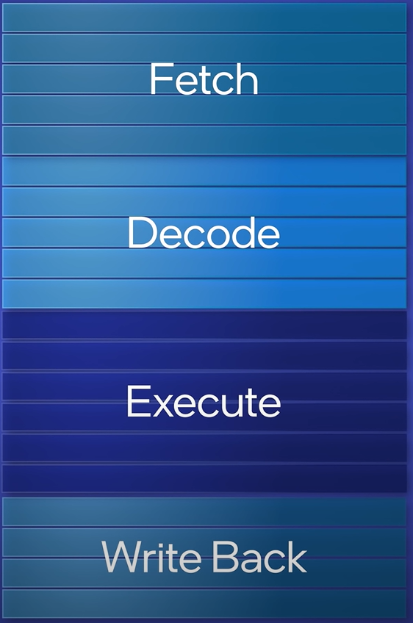
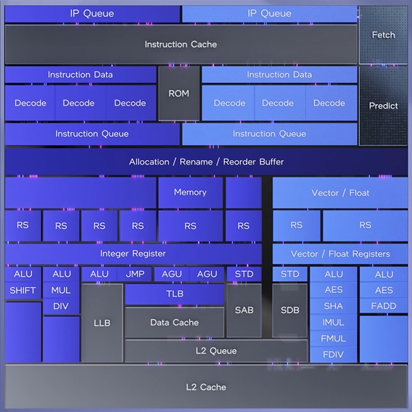
Pipe-Line
Pipe-Line
Traditionally: Fetch -> Decode -> Execute -> Memory_Access -> Write_Back
Intel Design - https://youtu.be/o_WXTRS2qTY
Many complex dependency issues which are solved in a very complex Architecture

Slide 11
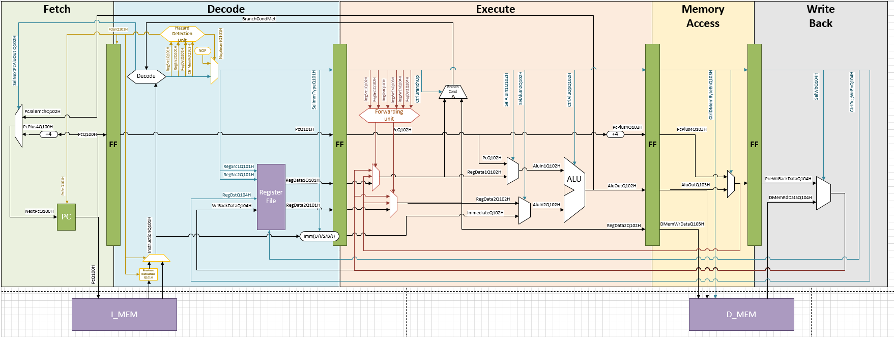
Pipe-Line
Pipe-Line
Simple 5 Stage, single issue RISCV Design.
3 Types of Hazards:
Data Hazard - Solved with Forwarding unit.
Load Hazard - Solved with Bubble + Back pressure + Forwarding unit.
Ctrl Hazard - Solved with Bubble + Back pressure + Pipe Flush.

Slide 12
Pipe-Line
Pipe-Line
“RISC” type CPU & ISA use a “load/store” architecture Meaning, to do any arithmetic on Memory Data you must: 1) “Load” Data from memory to Register File 2) Instruct an ALU operation 3) “Store” Data back to Memory from register file
Hack:
1) Hack is not a traditional “RISC” machine 2) The Memory Address is determent in the A Register. 3) Load & Store operation use the Same A register to determine the Data Address 4) Can Read-Modify-Write in a single instruction
> M = D + M

Slide 13
Pipe-Line
Pipe-Line
Need to support:
To execute these instruction in pipe-line fashion, need to have the “LOAD” execute speculatively for line (3) so the Data will be ready to enter ALU at line (4).
1) A = 5 // Write immediate to A
2) D = A // Save the Immediate to Register D
3) A = 10 // Write Address to register A
4) M = D + M // Calculate & Store: M[10] = 5 + M[10]

Slide 14
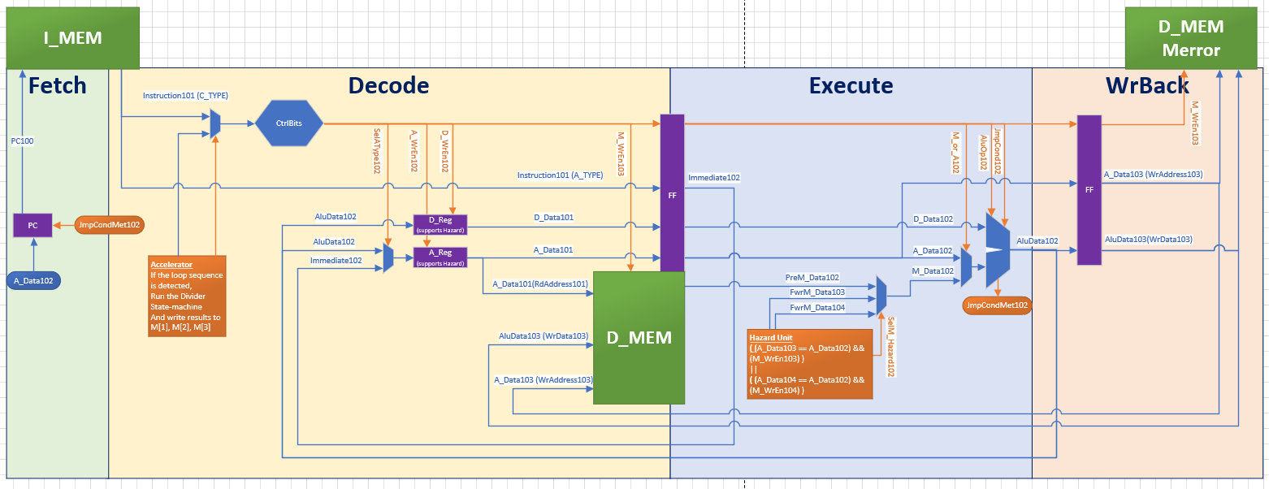
Pipe-Line |My Solution:
Pipe-Line
Load the Data from memory at the “Decode”
Data is ready for “Execute”.
Clear split of Data Path signals vs Control Signals.

Slide 15
Pipe-Line |My Solution:
Pipe-Line
Memory must support Dual Read & single Write in same cycle. (Decode, Write_Back, VGA)
We are limited to the FGPA standard memory types (which is at most dual port memory)
Dual Read & single Write is achieved by duplicating the D_MEM.

Slide 16
Multi-Issue
Multi-Issue
Simple dual issue:
Fetching 2 instructions from the ROM, we can decode them as a single entity and execute them together. This is known as fusion"fusion“
loading an immediate to register D:
loading from memory in a specific location to register D:
Storing to memory in a specific location the data of register D:
> @5 > D = A // D = 5
> @5
> D = M // D = M[5]
> @5 > M = D // M[5] = D

Slide 17
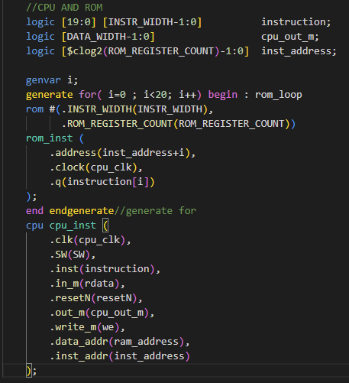
Multi-Issue
Multi-Issue
To support a multi-issue design, Fetch multiple Instruction per cycle.
Instantiate the Instruction memory multiple times and Fetch Subsequent 20 instruction. This is done using a “generate for”.

Slide 18
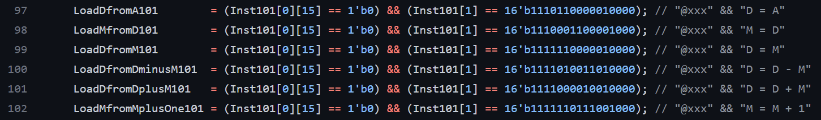
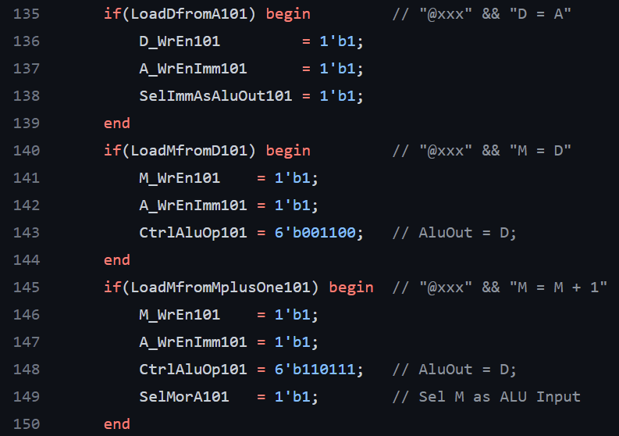
Multi-Issue
Multi-Issue
Dual Issue: Decode logic will Set the correct Ctrl bits for the Data Path

Slide 19
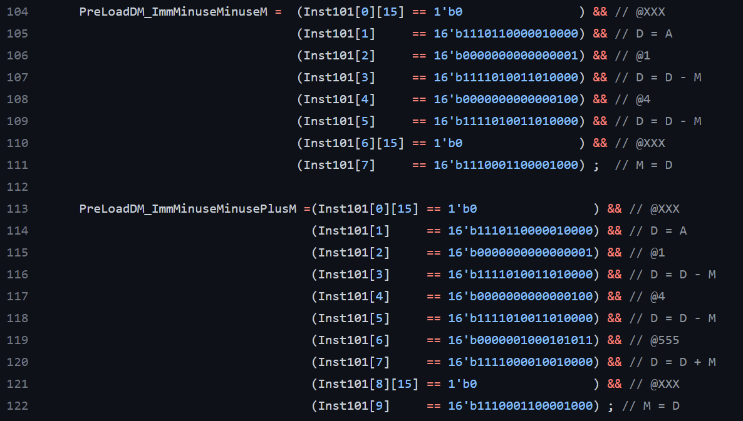
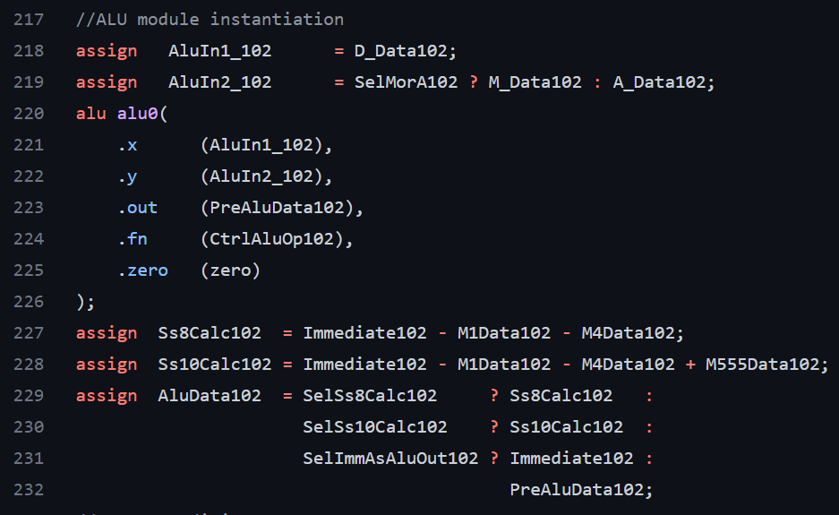
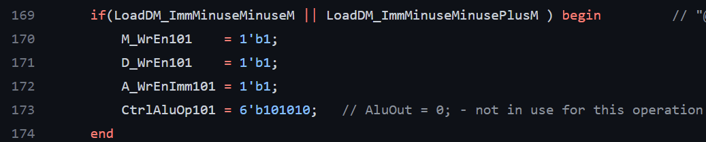
Multi-Issue
Multi-Issue
8 Multi-Issue instruction fusion into a single operation
10 Multi-Issue instruction fusion into a single operation
Ctrl Signals:
Dedicated HW for the fusion instructions

Slide 20
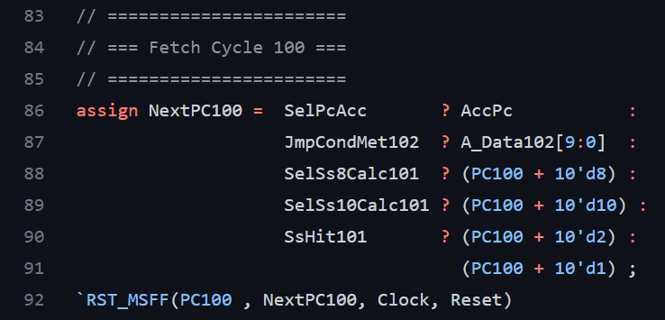
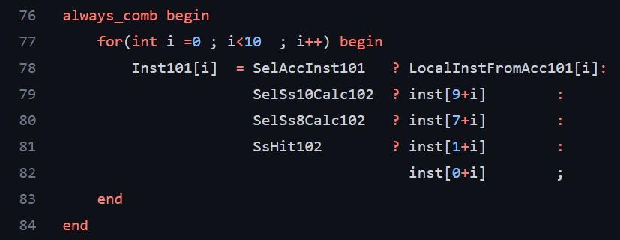
Multi-Issue
Multi-Issue
The program Counter needs to be incremented according to the decode Stage results:
The Instructions we decode are according to the new PC offset:

Slide 21
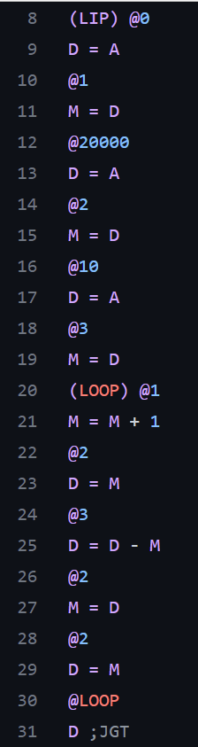
Integer Division Accelerator
Integer Division Accelerator
The Benchmark inner loop sequence of division:
Set M[1] to initial Value 0 (“Quotient”)
Set M[2] to initial Value 20,000 (“Dividend”)
Set M[3] to initial Value 10 (“Divisor”)
Start loop: Count # of Subtractions of Dividend from Divisor are larger than 0.
M[1] = M[1]++ // Quotient++
M[2] = M[2]-M[3] // Dividend – Divisor
If(M[2] >0) Jump to @LOOP
End of loop – M[1] has the final “Quotient” 0f M[2]/M[3]
M[1] = 0
M[2] = 20,000
M[3] = 10
(LOOP)
M[1] = M[1] +1
M[2] = M[2] – M[3]
If(M[2]>0)
jump @LOOP

Slide 22
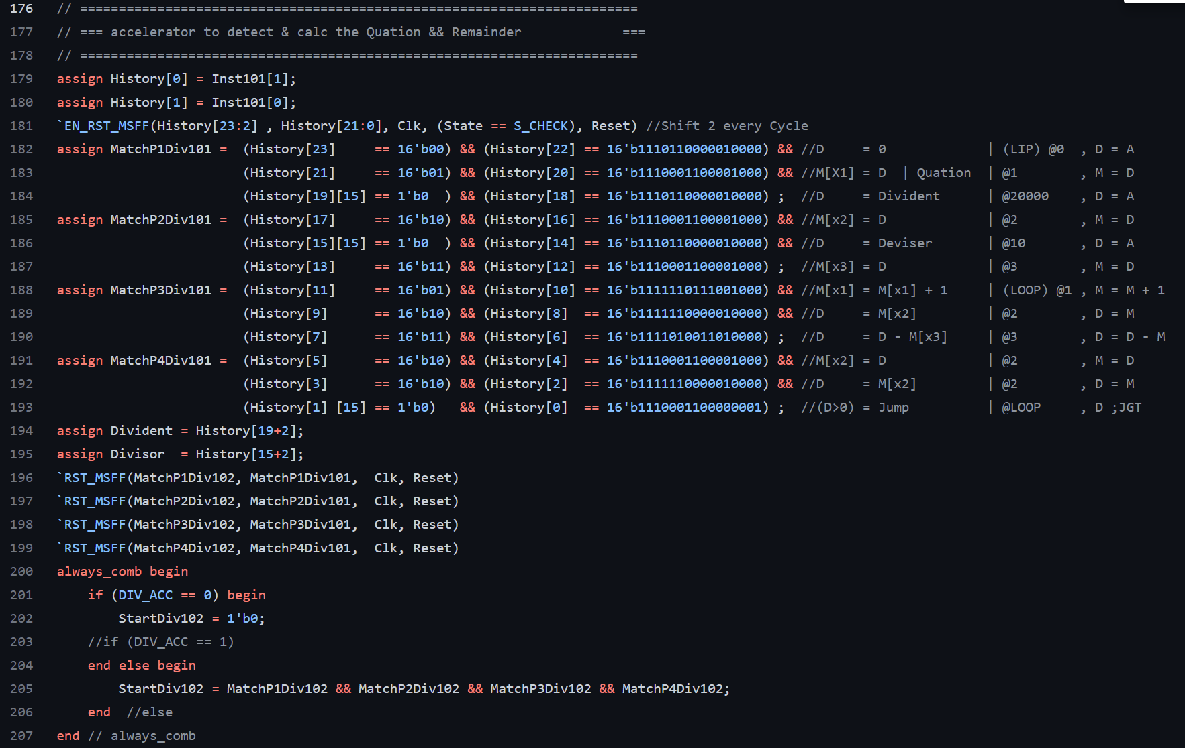
Integer Division Accelerator
Integer Division Accelerator
Detect the division LOOP using a “shift register” History buffer
Split the Match into 2 Cycles to ease the timing converges on the match logic

Slide 23
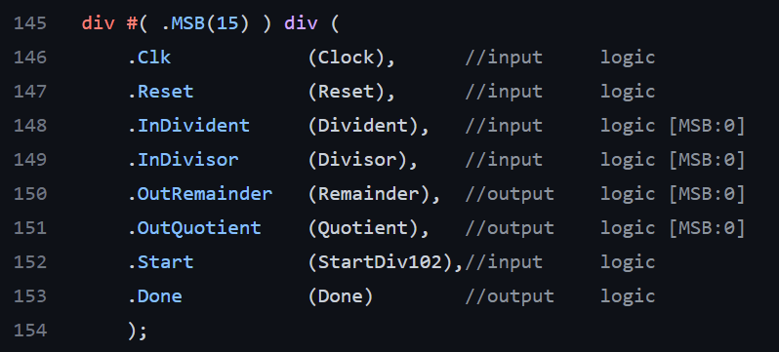
Integer Division Accelerator
Integer Division Accelerator
HW Division module Instance:

Slide 24
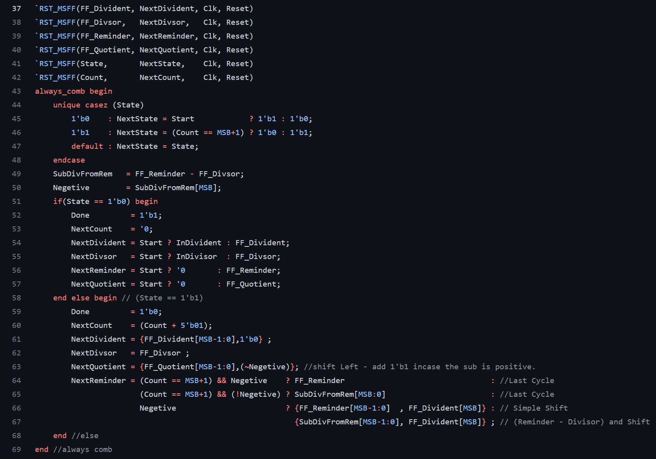
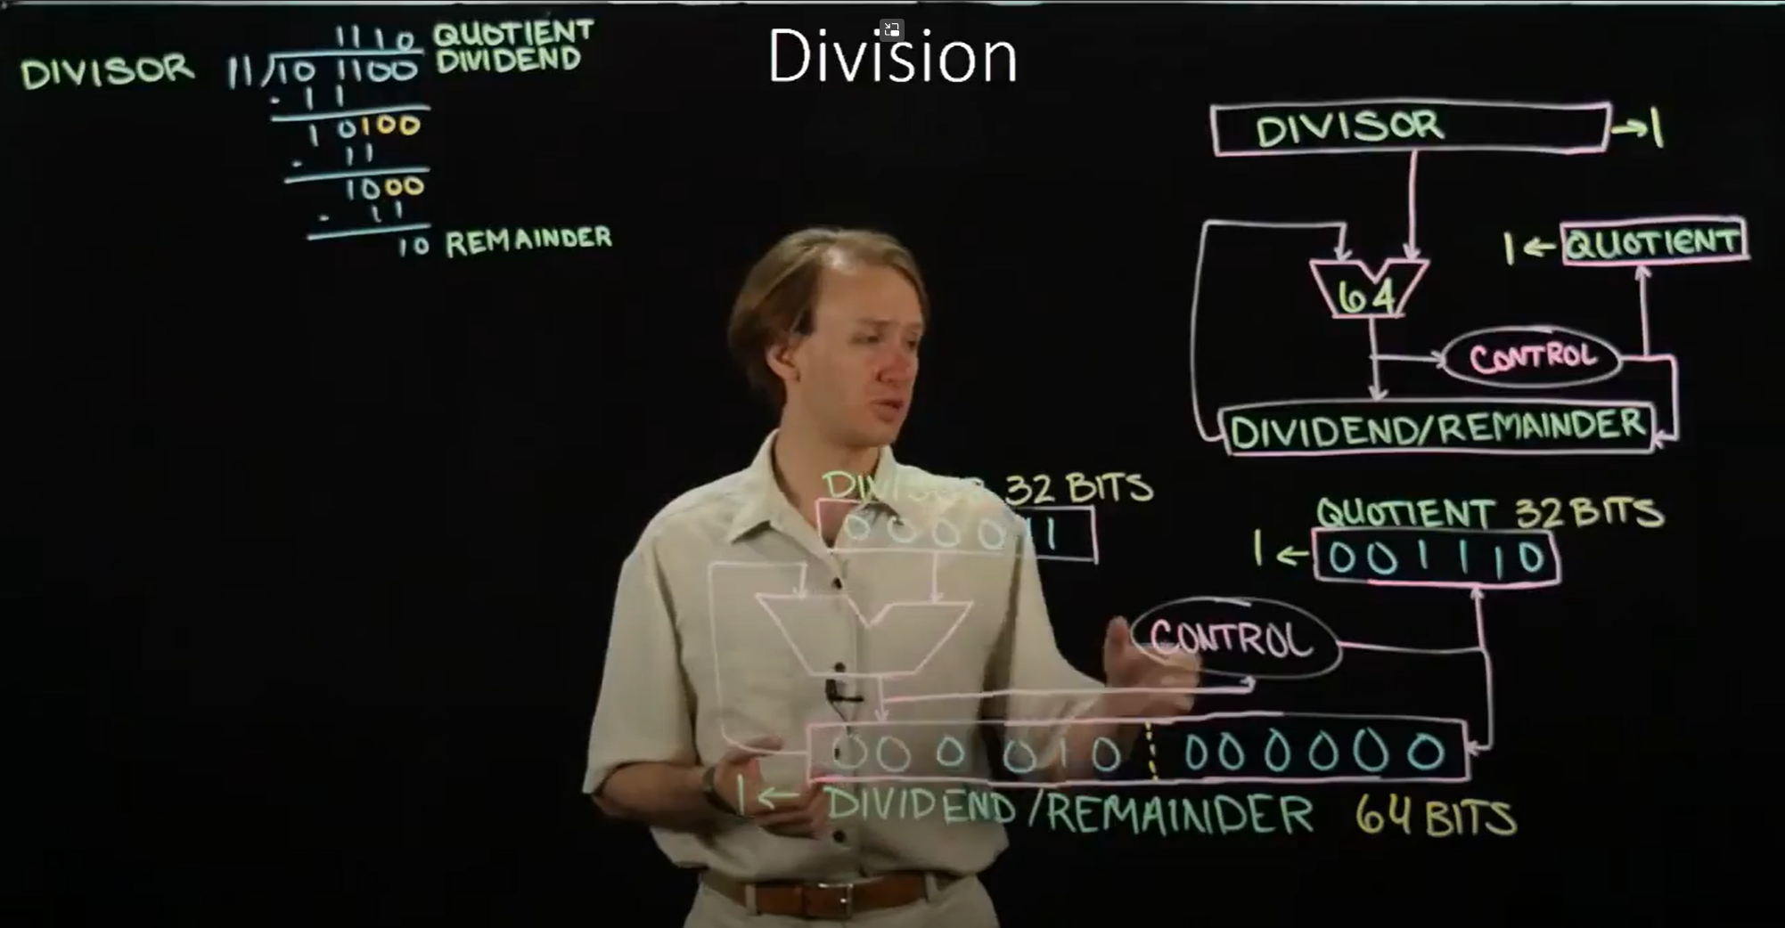
Integer Division Accelerator
Integer Division Accelerator
(170) 13-1. Improving the Division Hardware - YouTube
HW Division module Content:

Slide 25
Branch Prediction
Branch Prediction
Incase of Control Hazard, the pipe Needs to be flushed, and the PC will be updated accordingly.
Option 1: Insert 2 NOPs before setting the correct NextPC. This will make sure only correct commands will be executed.
Option 2: “Always Not Taken” – Keep fetching speculatively PC +1. only incase of ‘branch taken’ flush the Pipe and fetch correct instruction.
Option 3: “Always Taken” – Every Decode with potential branch, branch. Incase of wrong branch, flush and return to PC+1.
Option 4: Design a Branch predictor that can count the number of iteration a specific loop needs until branch not taken.

Slide 26
L1 Instruction Cache - Instruction Queue
L1 Instruction Cache
Add a ~30 Instruction deep instruction queue
Prefetch ~10 instructions every cycle.
Queue in Register Style - Allow multiple combinatorial reads from any entry in queue.
Fitch & Decode in a single Cycle. (combinatorial Fitch read) - Update Next PC more simply (multi-issue decode)
Instruction Queue deep enough to allow the critical loop to Brach without the need to fetch the instruction again.
Incase of branch that is not in L1 Cache

Slide 27
Performance analysis
Performance analysis
Out of the Box:
30,000 – # of LIP. Each is ~150 instructions + inner Loop
2,000 – # of LOOPs. Each is 12 instructions
Total:
30,000 x (2,000 x 12 + 150) = 724,350,000 -> ~14 sec.
The “Naïve solution” was a 2 Cycle per instruction (without Pipe- line).
As expected, we Got ~28 Sec

Slide 28
Performance analysis
Performance analysis
Pipe-line
30,000 – # of LIP. Each is ~150 instructions + inner Loop
2,000 – # of LOOPs. Each is 12 instructions + 2 for the pipe flush
Total:
30,000 x (2,000 x (12+2) + (150+2)) = 724,350,000 -> ~16 sec.

Slide 29
Performance analysis
Performance analysis
Dual-Issue
30,000 – # of LIP. Each is ~150 instructions + inner Loop
2,000 – # of LOOPs. Each is 12 instructions + 2 for the pipe flush
Total:
30,000 x (2,000 x (12/2+2) + (150/2+2)) = 482310000 -> ~9.6 sec.

Slide 30
Performance analysis
Performance analysis
Multi-Issue
30,000 – # of LIP. Each is ~150 instructions + inner Loop
2,000 – # of LOOPs. Each is 12 instructions + 2 for the pipe flush
Total:
30,000 x (2,000 x (12/4+2) + (150/7+2)) = 301,185,000 -> ~6 sec.
Average

Slide 31
Performance analysis
Performance analysis
Instruction queue + Branch always Taken:
30,000 – # of LIP. Each is ~150 instructions + inner Loop
2,000 – # of LOOPs. Each is 12 instructions + 2 for the pipe flush
Total:
30,000 x (2,000 x (12/4 +2) + (150/7 +2)) = 181,125,000 -> ~3.6 sec.
Average

Slide 32
Performance analysis
Performance analysis
HW devider:
30,000 – # of LIP. Each is ~150 instructions + inner Loop
2,000 – # of LOOPs. Each is 12 instructions + 2 for the pipe flush
12 + 17 Instruction for the HW devider
Total:
30,000 x ( (12 + 18) + (150/7)) = 1542857 -> ~0.03 sec.
Detect Division is needed
Perform 16-bit Division

Slide 33
Questions

